Slide 1
DRIVER DROWSINESS DETECTION SYSTEM
Presented by:
Raman Agarwal
Romik Roy
Shagun Priya
Rahul kumar Verma

Slide 2
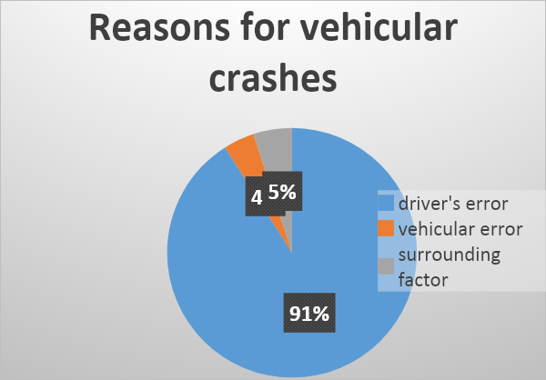
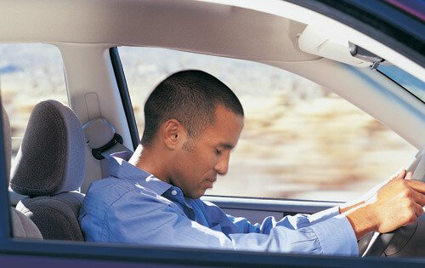
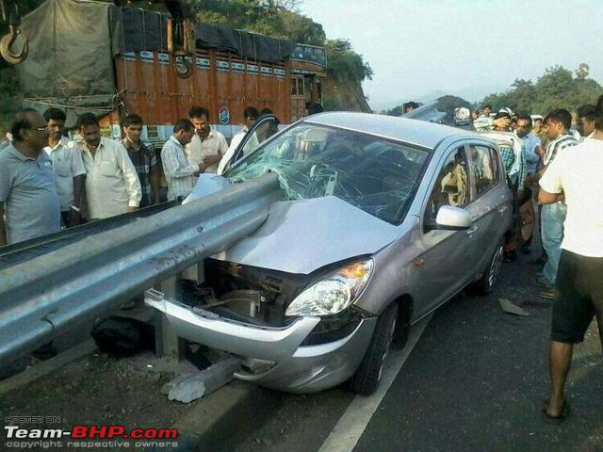
Introduction
Drowsiness is defined as a decreased level of awareness portrayed by sleepiness and trouble in staying alert.
Action
Reaction
Fig. 01: A person is feeling drowsy
Fig. 02: Accident happens

Slide 3
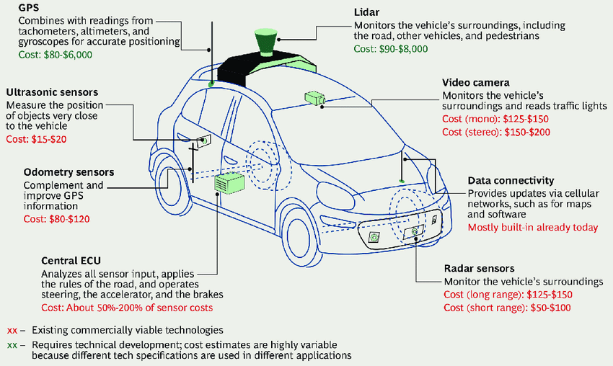
Can We Detect Drowsiness ?
Yes, it is possible to measure drowsiness indirectly and it can be measured in the following ways:
1. Vehicle based measures. 2. Physiological measures. 3. Behavioral measures
1. Vehicle-based measures:
Ultrasonic Sensors.
Lidar.
Radar Sensors.
Fig. 03: Vehicle- based measurement system.

Slide 4
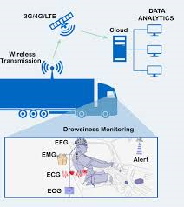
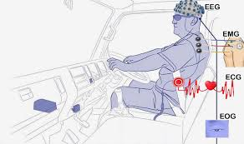
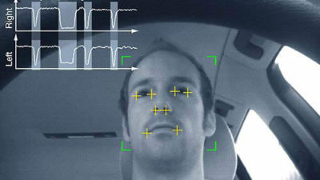
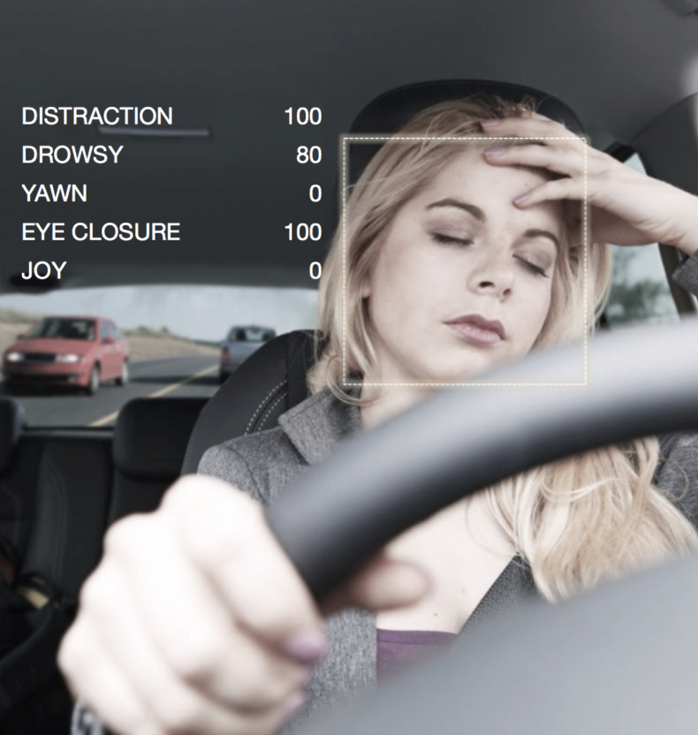
2. Physiological measures:
ECG- (electro cardiogram)
EEG- (electroencephalogram)
EOG- (electro occulogram)
EMG- (electromyogram)
Fig. 05 : fig. 04 and fig. 05 Both are
showing the physiological
measurement system.
Fig. 04
3. Behavioral measures:
1. Yawning.
2. Amount of eye closure.
3. Eye blinking.
4. Head position.
Fig. 06: Detecting the state of eyes.
Fig. 07: Drowsy state.

Slide 5
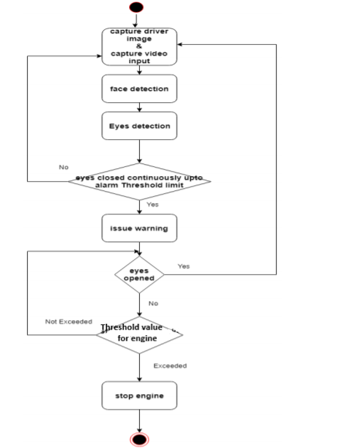
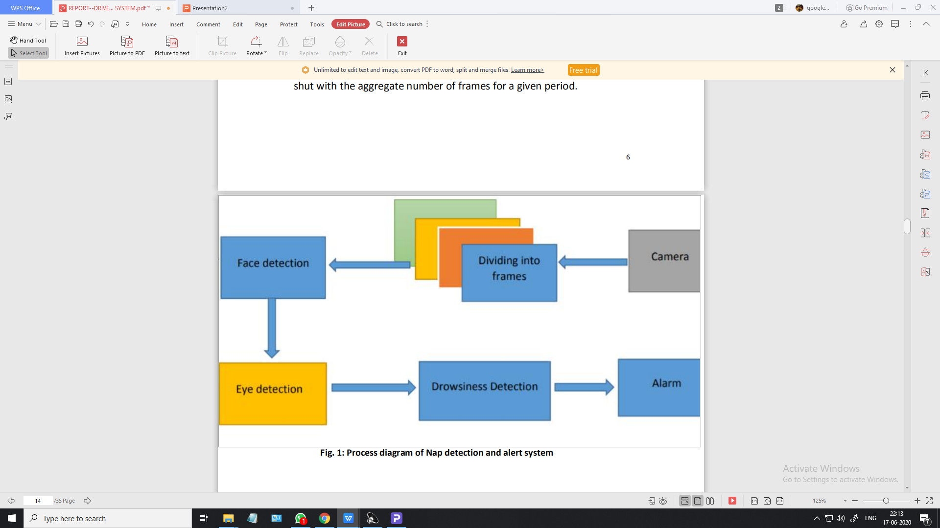
Our Approach to Driver Drowsiness Detection
Fig. 08: Process diagram of drowsiness(Nap) detection &
alert system.
Fig. 09: A Flow chart for Nap detection & alert
system.

Slide 6
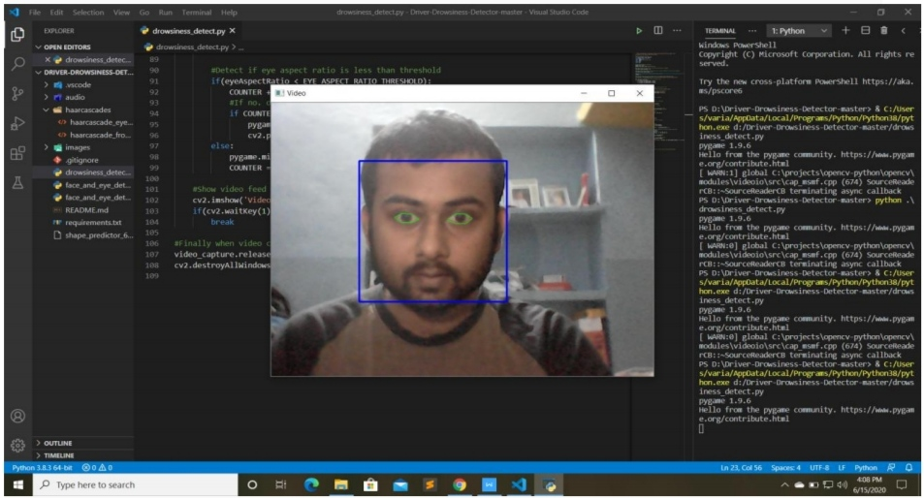
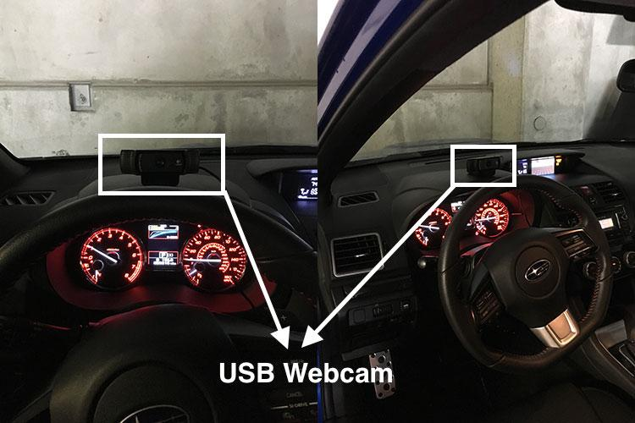
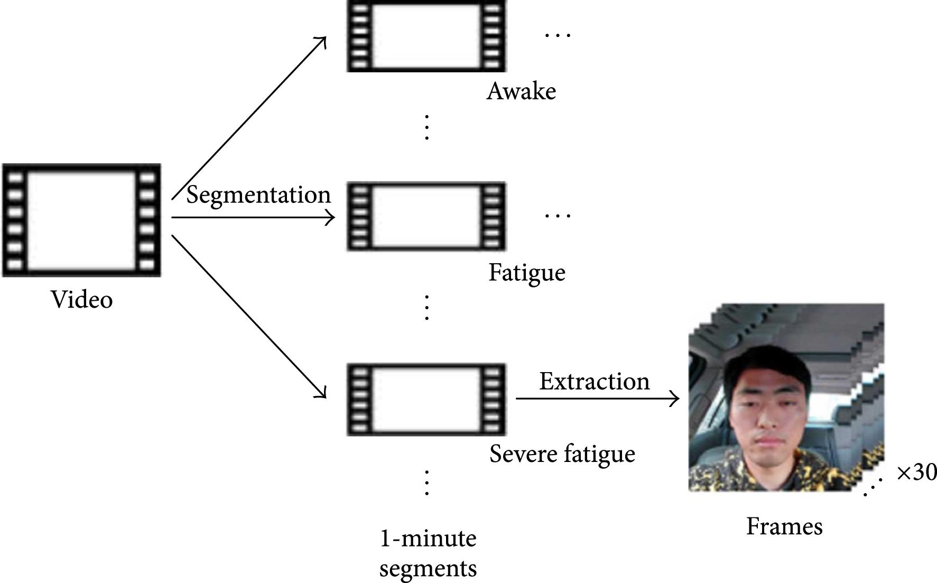
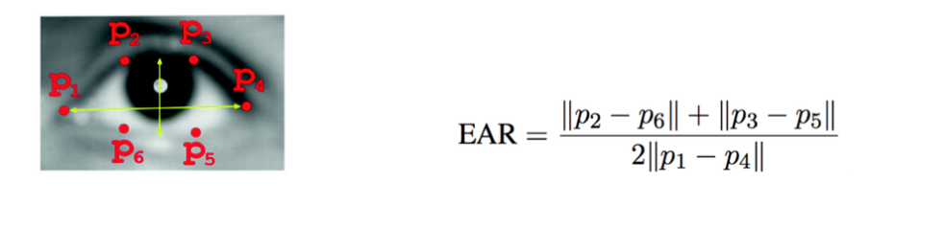
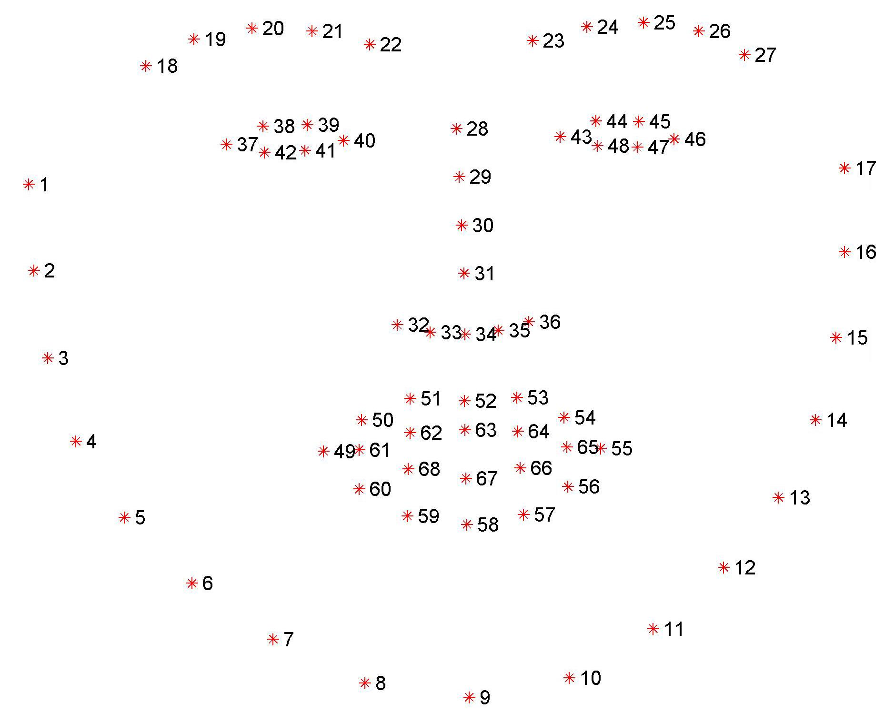
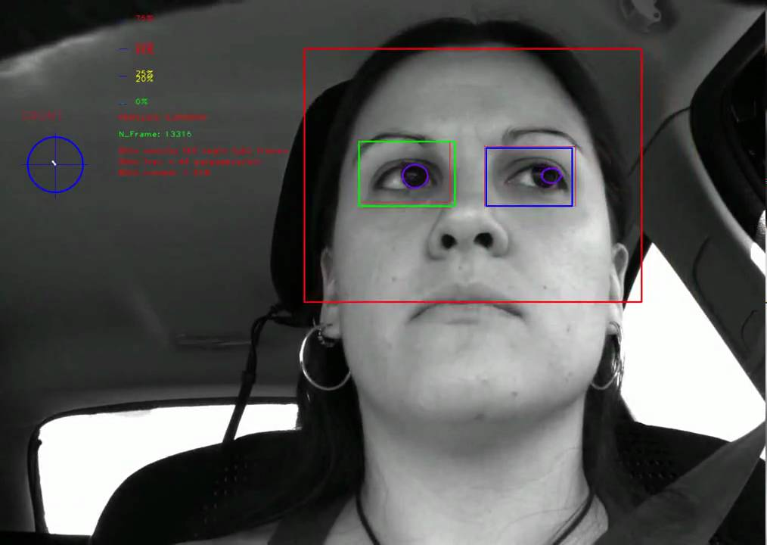
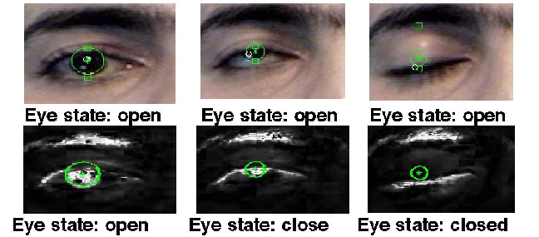
Process Steps
Step 3: Face
Detection
Step 1: Utilizing a web camera inside the automobile
to get the picture/live video of the driver.
Step 2: Dividing the video footage
into Frames
→
Step 6: Calculation of Eye-Aspect-ratio
Step 5: Eye Detection
Step 4: Facial landmarks location
Step 7: Determining State of eye

Slide 7






Programming Laguage and Packages Used
1. Python
2. NumPy
3. Pygame
4. OpenCV
5. SciPy
6. Imutils package

Slide 8
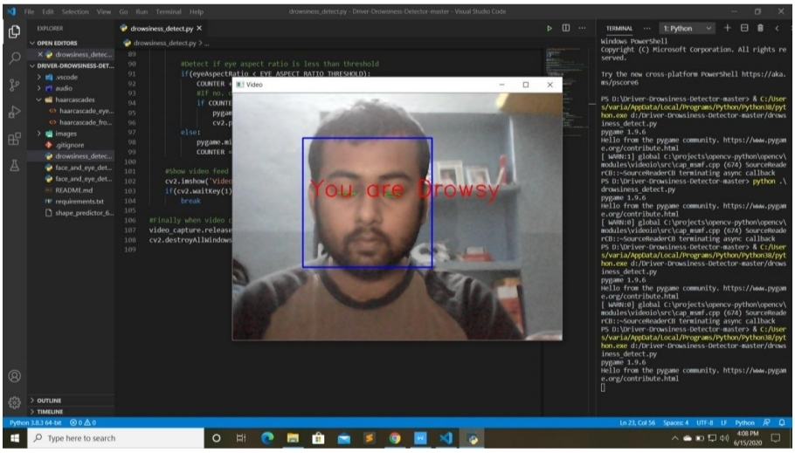
Output/Result
The person is not in Drowsy State.
Fig. 10: Eye in open state with head position = straight
The person is in Drowsy State.
an alarm is activated.
Fig. 11: Eye in closed state with head position = straight

Slide 9
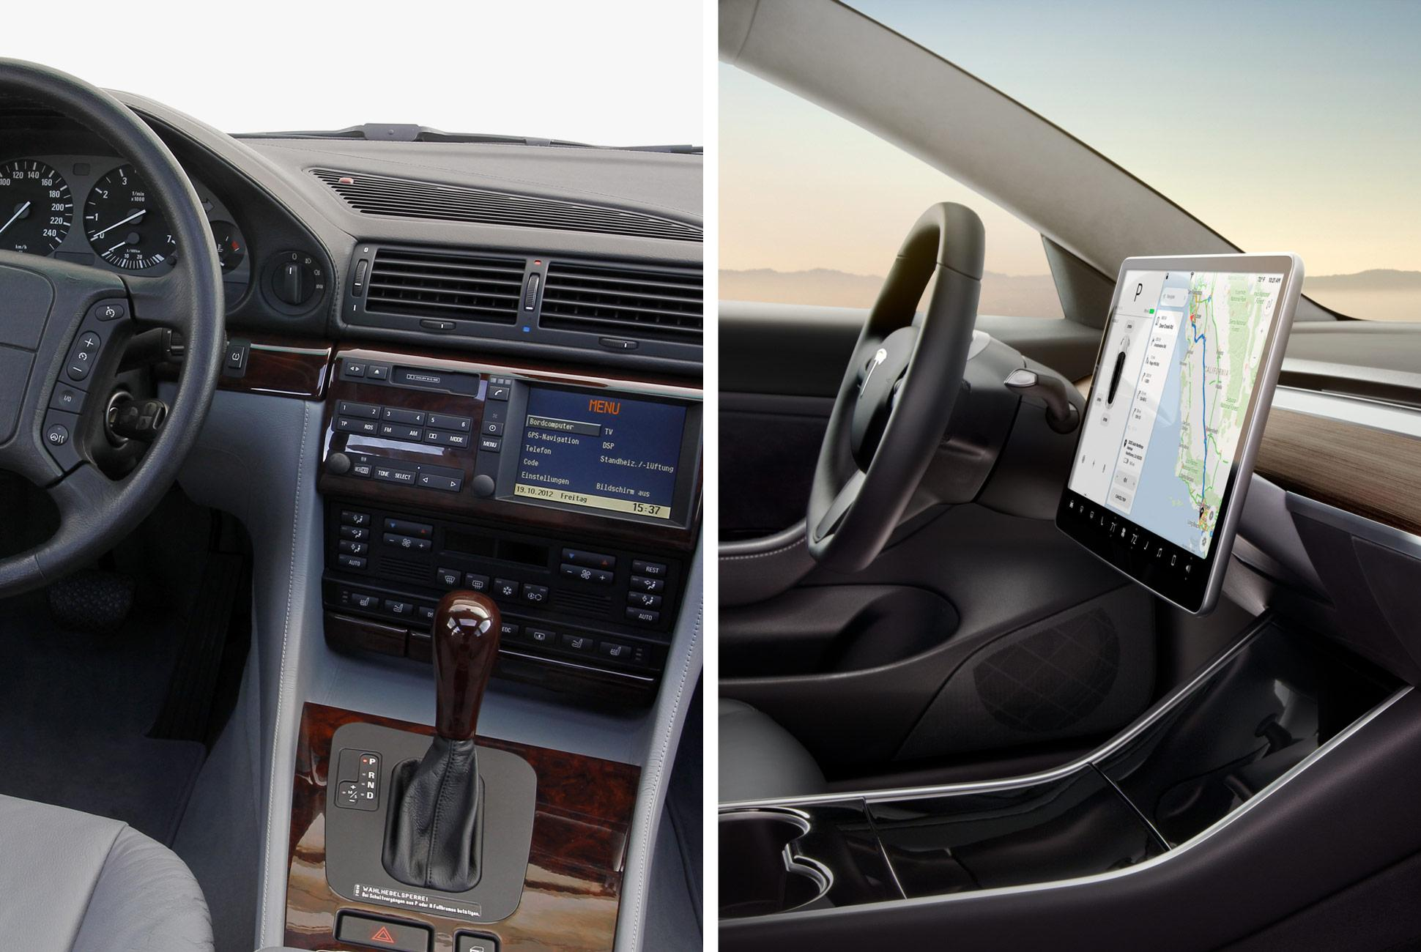
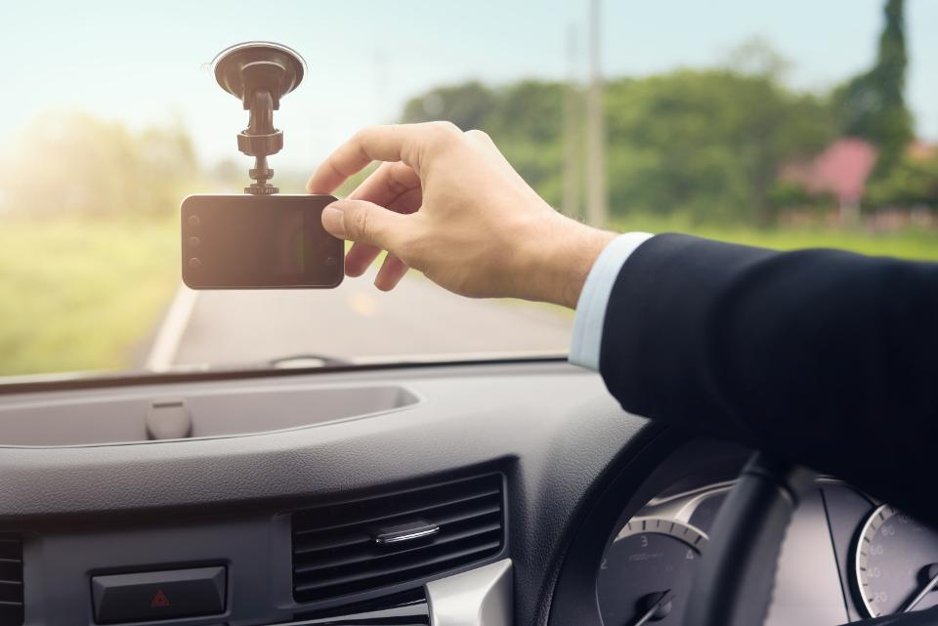
FUTURE SCOPE
Standalone product:
Installed in an automobile for monitoring the
automobile driver.
Fig. 12: Shows Standalone products are installed.
Smart phone application:
(1) Installed on smart phones.
(2) Placed it at a position where the camera is
focused on the driver.
Fig. 13: Smart phone is used for monitoring the driver

Slide 10
CONCLUSION
In this implementation during the drowsy state a message is shown to the screen and an alarm is activated. If the driver is not drowsy then the message is not shown to the screen and the alarm is not activated.
Thus we have successfully designed a prototype drowsiness detection system using OpenCV, dlib, SciPy, imutils libraries and python as coding platform.

Slide 11
References
[1] Karamjeet Singh, Rupinder Kaur, ”Physical and Physiological Drowsiness Detection Methods”, IJIEASR, pp.35-43, vol.2,2013.
[2] Jarek Krajewski, David Sommer, ”Steering Wheel Behavior Based Estimation Of Fatigue”, Fifth International Driving Symposium on Human Factors in Driver Assessment, Training and Vehicle Design,Germany.
[3] Behnoosh Hariri, Shabnam Abtahi, Shervin Shirmohammadi, Luc Martel,” A Yawning Measurement Method to Detect Driver Drowsiness “.Vandna Saini et al, / (IJCSIT) International Journal of Computer Science and Information Technologies, Vol. 5 (3), 2014,4245-4249
[4] K. C. Yowand, R. Cipolla, “Feature-based human face detection, “Image Vision Comput., vol.15, no.9, 1997, pp.713–735.
[5] Xia Liu; Fengliang Xu; Fujimura, K., "Real-time eye detection an tracking for driver observation under various light conditions," Intelligent Vehicle Symposium, 2002. IEEE , vol.2, no., pp.344,351 vol.2, 17-21 June 2002.
[6] Xianghua Fan, et.al, "The system of face detection based on OpenCV," Control and Decision Conference (CCDC), 2012 24th Chinese , vol., no., pp.648,651, 23-25 May 2012.

Slide 12
Thank you

